Slide 1
Understanding Georgia Unemployment Benefits in the Wake of COVID-19
Mary Claire Smith
Jackson Lewis P.C. - Atlanta
April 2, 2020
Notes:
TJM

Slide 2
The Basics
Georgia’s Partial Unemployment Benefits
Employer Filing Obligations
What Must Employees Do
Federal Government’s Stimulus Plan – The CARES Act
Notes:
TJM

Slide 3
The Basics: What are Unemployment Benefits?
Unemployment benefits are cash payments to workers who are no longer employed by you “through no fault of their own.”
Typically, benefits are fully funded by taxes paid by employers into an Unemployment Insurance Trust Fund.
All employers have some obligations under the unemployment security laws, but not all are required to pay taxes into the system.
Your employer status determines whether and how much you are required to pay into the GA unemployment system.
You should have set up an unemployment insurance account with the GADOL into which your contributions are paid.
Notes:
TJM
Employees do not contribute to the fund and employers cannot take any portion of employees wages to pay into the fund.

Slide 4
The Basics: Do non-profits have to pay into the system?
Non-profit organizations are required pay into the system if they have at least 4 employees who work some or part of a day in each of 20 weeks during a calendar year.
Georgia only recognizes non-profit organizations that have been issued a 501(c)(3) exemption by the federal IRS.
Independent contractors do not count as your employees IF they truly are independent contractors. Independent contractor status is a high bar to reach and many employers get it wrong.
Notes:
TJM
Georgia makes no distinction between being part-time, full-time, sometimes, long-term, or temporary. If you had 4 or more people working for you, they are employees and you are the employer for purposes of unemployment benefits.
501©(3) status is important because otherwise, your organization could be treated like a regular private employer and only need 1 worker to perform work over a 20 week period and, the tax liability is higher. You also have quarterly obligations to report your payroll and to pay your unemployment tax into the system on a quarterly basis.
Incorrectly defining someone as an independent kor can create significant liability and penalties from the GADOL and the IRS. There is a multi factor test to determine whether someone really qualifies as an independent contractor and most workers do not satisfy this test.

Slide 5
Georgia Partial Unemployment Benefits
On March 19, 2020, the GADOL enacted Emergency Rule 300-2-4-.05, which requires employers to file partial claims for unemployment for full and part-time employees who are temporarily laid off or whose hours have been temporarily reduced because of a lack of work due to COVID-19.
Notes:
MCS

Slide 6
Partial Unemployment – Who is Eligible?
Employees who are temporarily laid off or have reduced hours because of lack of work due to COVID-19
Employees must be expected to return to work when COVID-19 emergency ends
They must be U.S. citizens or non-citizens authorized to work in U.S.
Notes:
MCS

Slide 7
Partial Benefits – Who is Not Eligible?
Employees on scheduled/customary vacation or leave, scheduled/customary plant shut/down or closure
Employees of a temporary agency currently working at your business
Employees employed in another state or employed by the federal government in the last 18 months
1099 employees
Employees who are voluntarily out of work due to requested leave of absence, self-quarantine, etc.
Employees permanently separated from your company
Notes:
MCS

Slide 8
What Benefits are Potentially Available?
Maximum benefits available are $365/week for up to 26 weeks under Georgia enhanced benefits
Under the CARES Act, workers get an additional 13 weeks - up to 39 total weeks of benefits
For persons who are still working but at reduced pay, earnings of $300 or less will not be deducted from the weekly benefit amount. Any earnings over $300 will be deducted from the maximum weekly benefit amount
Notes:
MCS
The total number varies by state. CARES Act provides an additional 13 weeks; some states provide more weeks from the outset.

Slide 9
Employer Obligations
Employers must file claims on behalf of each employee via Employer Portal
May file single claims or multiple claims using DOL multi-claims template
Claims must be re-filed weekly (or multi-claim template updated and resubmitted weekly). File after the payment week has ended
Information required: employee name, SSN #, Address, date of birth, whether employee wants to withhold income taxes, gross earnings (including any leave pay, vacation pay, holiday pay earned by the employee that week)
You must tell employees: (1) you are filing the claim for them; (2) they can elect to have taxes withheld; (3) they have direct deposit option
Additional information can be found at https://dol.georgia.gov/covid-19-employer-faqs
Notes:
MCS

Slide 10
PENALTIES
Any employer found to be in violation of the new rule will be required to reimburse the GDOL for the full amount of unemployment insurance benefits paid to the employee.
Notes:
MCS

Slide 11
What do your employees need to do?
Employees have the option of receiving benefit payments via direct deposit or the Georgia UI Way2Go Debit Mastercard
After you file claims on behalf of your employees, employees may change the payment method by visiting the UI Benefit Payment Methods page on the GDOL website
They will set up a 4-digit PIN on the UI Benefit Payment Method page on the GDOL website
Employees can then check the status of their claim by selecting the Check my UI Claim Status page on the GDOL website
Claims are typically processed within 48 hours
If an employee receives notification from GDOL that their claim is not monetarily valid due to insufficient wages and they have employment in other quarters, they should contact their local career center for assistance
Notes:
MCS

Slide 12
The CARES Act

Slide 13
CARES Act
Two categories of workers eligible for new and/or enhanced unemployment benefits under CARES:
Employees currently eligible for unemployment benefits under Georgia law; or
“Covered Individuals” not currently eligible under State law but who self certify that they are able to work but partially unemployed due to…..
Notes:
MCS

Slide 14
CARES Act Cont’d.
Diagnosis of COVID19 or experiencing symptoms
Providing care for a family member diagnosed with COVID19
Primary caregiver for a child or other household member unable to attend school or facility due to COVID19
Unable to reach employment because place of employment is closed due to COVID19 quarantine
Unable to work because healthcare provider has advised the individual to self-quarantine due to COVID19
Individual was scheduled to commence employment and does not have a job or is unable to reach the job as a direct result of COVID19
Individual has become breadwinner or major support of household because head of household has died as a result of COVID19
Individual has to quit job because of COVID19
Place of employment is closed because of COVID19
Notes:
MCS

Slide 15
What do I need to do to help my employees get the CARES benefits?
If employees are receiving unemployment benefits, there is nothing additional the employer needs to do. The CARES monies will be automatically added to their GA weekly benefits beginning this week.
The $600 is an additional supplement to the regular weekly state unemployment benefits and will include all eligible weeks beginning with the week ending 4/4/2020
The payment may not be $600 if the employee has elected to have state and federal taxes deducted
Other deductions may include court ordered of voluntary child support or repayment of a UI overpayment
Notes:
MCS

Slide 16
Pandemic Unemployment Assistance (PUA)
PUA provides benefits to those not eligible under state law (independent contractors, gig workers, self-employed individuals)
These individuals must be deemed ineligible for state benefits before being evaluated for federal benefits
Individuals should file a regular state unemployment claim, and a written determination of eligibility will be released
Once they are determined not eligible, they will receive an email with instructions for a PUA application

Slide 17
QUESTIONS
Notes:
TJM

Slide 18
What is the difference between a furlough and a layoff?
Notes:
Furloughs are intended to be temporary; employer anticipates the employee will return to work. Cannot exceed 6 months; sometimes benefits can continue depending on what your carriers’ requirements are.
Layoffs generally are permanent.

Slide 19
So, what do I tell my employees to do to get their unemployment benefits started?
Notes:
TJM
If employees are being laid off, you will need to provide them with a GA DOL Separation Notice, that you have completely filled out for each worker. It is GADOL Form 800. The employee will take the form to the local DOL office in the county where they live. They will be signed in, their paperwork entered into the system, and interviewed by an agent to be sure they are eligible for benefits and to determine how much they are entitled to receive. They will not need to sign up for new work.
If employee is only partially unemployed, you the employer must submit claim to the DOL via the employer portal. Tell your employee to head to the DOL office in her county of residence. The DOL will take care of the rest.
Tell them to pack their patience. With the latest statewide shut down, it may take a few days to get through the lines to see a claims officer.

Slide 20
I have a lot of part-time and contract workers. Are they covered by the Georgia plan, the CARES Act, or both?
Notes:
TJM
Georgia does not pay out independent contractors – unless they actually qualify as employees, but the CARES Act does provide benefits to independent contractors. If your contract workers are temp employees from an agency, they generally are not your employees. Their agency is the employer and the agency will need to be responsible for filing for their benefits.

Slide 21
What if I have employees in other states to lay off? How does unemployment work for them?
Notes:
TJM
Unemployment processes vary by state. You will have to go to the state agency’s guide for that state. If you have employees who work in multiple states, they are eligible only for benefits from one state. Generally, they are paid from the base state where most of their work is conducted.

Slide 22
I only hire workers on a part-time, as needed basis. Do I have to file unemployment benefits for them?
Notes:
TJM
Yes, if you had at least 4 workers in at least 20 weeks over the last year. You will have to file benefits if you are filing partial claims. If employees are being permanently separated, you must provide an individual Georgia Separation Notice. It is GA DOL Form 800.

Slide 23
More Questions???

Slide 25
About Jackson Lewis P.C.

Slide 26
As legal professionals focused on the workplace, we have a unique vantage point into the human condition.
It is our privilege to do work that affects real people.
It is our calling to craft policies that achieve the delicate balance between supporting diverse workers and the businesses that employ them.

Slide 27
Firm overview
We represent management exclusively in every aspect of employment, benefits, labor, and immigration law and related litigation.
As leaders in educating employers about the laws of equal opportunity, Jackson Lewis understands the importance of having a workforce that reflects the various communities it serves.
With 61 locations and more than 950 attorneys, we offer local knowledge backed by the support of a national firm.
We are founding members of L&E Global, a global alliance of premier employer’s counsel firms.

Slide 28
National recognition
Recognized for excellence and ranked as a Tier 1 National “Best Law Firm” by U.S. News — Best Lawyers® for:
Employment Law – Management;
Labor Law – Management; and
Litigation – Labor & Employment.
More than 70% of Jackson Lewis’ firm locations also received a Tier 1 Metropolitan designation in various labor and employment categories.
Recommended in The Legal 500 United States 2019 for:
Employee Benefits, Executive Compensation and Retirement Plans: Design;
Immigration; Labor and Employment Disputes (including collective actions): Defense;
Labor-Management Relations; and
Workplace and Employment Counseling.
72 attorneys have been recognized in the 2019 edition of Chambers USA: America’s Leading Lawyers for Business. More than 200 attorneys were selected for inclusion in the 2019 edition of The Best Lawyers in America©.
Designated as a “Powerhouse” in Everyday Employment Litigation in Complex Employment Litigation in BTI Litigation Outlook 2019: Changes, Trends and Opportunities for Law Firms.

Slide 29
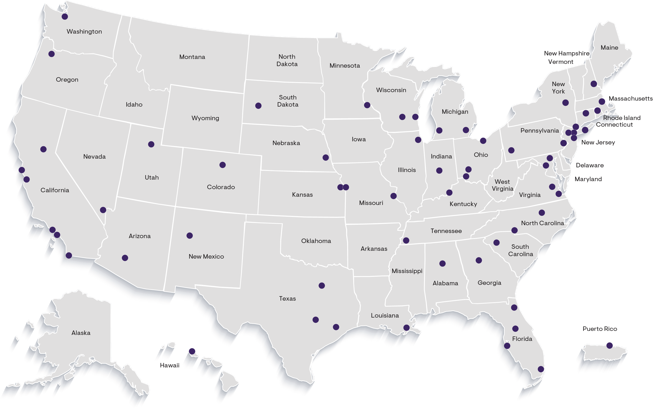
Strategically located to serve employers’ needs
61
Locations Nationwide
950
+
Attorneys

Slide 30
Class Actions and Complex Litigation
Collegiate and Professional Sports
Corporate Diversity Counseling
Corporate Governance and Internal Investigations
Disability, Leave and Health Management
Employee Benefits
General Employment Litigation
Health Law and Transactions
Immigration
International Employment Issues
Labor and Preventive Practices
Non-Competes and Protection Against Unfair Competition
Privacy, Data and Cybersecurity
Wage and Hour
White Collar and Government Enforcement
Workplace Safety and Health
Workplace Training
Practices

Slide 31
Automotive
Chemicals
Construction
Energy and Utilities
Financial Services
Government Contractors
Healthcare
Higher Education
Hospitality
Insurance
Life Sciences
Manufacturing
Media
Professional Services
Real Estate
Retail and Consumer Goods
Staffing and Independent Workforce
Technology
Transportation
Industries

